Slide 1

Object Oriented Analysis and Design
CS-309
Use Case Realization
Lecture # 33
19 Nov
Rubab Jaffar
rubab.jaffar@nu.edu.pk

Slide 2
Today’s Outline
Analysis and Design
Use case Realization
Analysis Classes
ECB Pattern

Slide 3
Analysis and Design
Analysis
Focus on understanding the problem
Idealized design
System behavior
System structure
Functional requirements
A small analysis model
Design
Focus on understanding the solution
Operations and attributes
Performance
Close to real code
Non-functional requirements
A large model

Slide 4
Analysis and Design
Architecture Analysis
Architectural Analysis is where an initial attempt is made at:
Defining the pieces/parts of the system and their relationships
Organizing on these pieces/parts into well-defined layers with explicit dependencies
Concentrating on the upper layers of the system
While the above is easy to say, there are specific steps identified in RUP to assist in this effort
4

Slide 5
Use Case Realization
use-case realization describes how a particular use case is realized within the Design Model, in terms of collaborating objects.
A use-case realization is one possible realization of a use case.
A use-case realization in the Design Model can be traced to a use case in the Use-Case Model.
A realization relationship is drawn from the use-case realization to the use case it realizes.
A use-case realization can be represented using set of diagrams.

Slide 6
Use Case Realization
The diagrams that may be used to realize a use case realization may include:
Interaction Diagrams (sequence and/or collaboration diagrams) can be used to describe how the use case is realized in terms of collaborating objects.
These diagrams model the detailed collaborations of the use-case realization.
Class Diagrams can be used to describe the classes that participate in the realization of the use case, as well as their supporting relationships.
These diagrams model the context of the use-case realization.

Slide 7
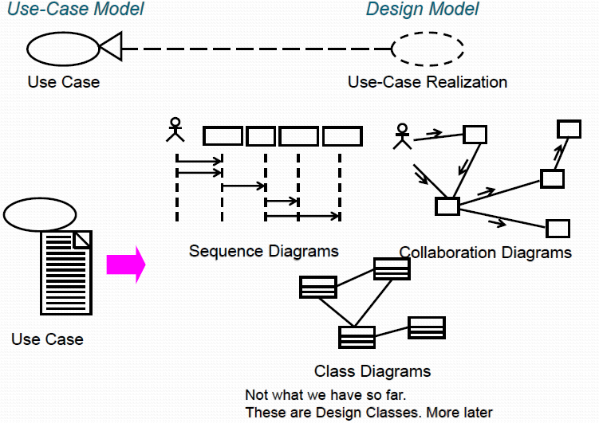
Use Case Realization

Slide 8
Who does Use Case Realization?
A designer: responsible for the integrity of the use-case realization.
Must coordinate with the designers responsible for the classes and relationships employed in the use-case realization.
The use-case realization can be used by class designers to understand the class’s role in the use case and how the class interacts with other classes.
This implies that a team will/may distribute responsibilities for each class to developers.
This information can be used to determine/refine the class responsibilities and interfaces.
Let’s find the classes from different behaviors the classes must provide…

Slide 9
Review: Use-Case Realization?
Development is the process of creating a system from requirements
A use case realization ties together the use cases from the Use Case Model with the classes and relationships of the design model
A use case realization specifies what classes must be built to implement each use case

Slide 10
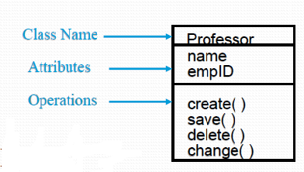
Review: Class
A class is a description of a set of objects that share the same attributes, operations, relationships, and semantics
A class is an abstraction in that it
Emphasizes relevant characteristics; suppresses others
Consists of the three sections indicated
First section: Class name
Second section: structure (attributes)
Third section: behavior (operations)
For analysis classes, these entries are sufficient!
An object is an instance of a class with a well-defined boundary and unique identity that encapsulates state and behavior
Encapsulation is the hiding of a software object’s internal representation

Slide 11
Analysis Classes - Early Conceptual Model
The analysis classes, taken together, represent an early conceptual model of the system.
This conceptual model evolves quickly and remains fluid for some time as different representations and their implications are explored.
Analysis classes are early estimations of the composition of the system; they rarely survive intact into implementation.
Many of the analysis classes morph into something else later on (subsystems, components, split classes, combined classes).
They provide us with a way of capturing the required behaviors in a form that we can use to explore the behavior and composition of the system.
Notes:
Analysis classes allow us to "play" with the distribution of responsibilities, re-allocating, as necessary.

Slide 12
Identifying Candidate Classes from Behavior
Will use three perspectives of the system to identify these classes.
The ‘boundary’ between the system and its actors
The information’ the system uses
The ‘control logic’ of the system
Will use stereotypes to represent these perspectives (boundary, control, entity)
These are conveniences used during analysis that will disappear or be transitioned into different design elements during the design process.
Will result in a more robust model because these are the three things that are most likely to change in system and so we isolate them so that we can treat them separately.
That is, the interface/boundary, the control, and the key system entities.….

Slide 13
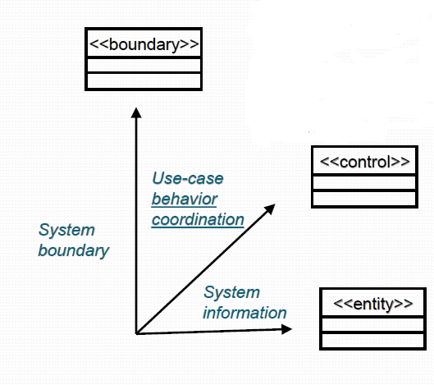
What is an Analysis Class?

Slide 14
What is an Analysis Class?
Can use with the name of the stereotype In guillemets or as symbols with unique icons.
Finding a candidate set of classes is the first part of transforming a mere statement of required behavior to a description of how the System will work.

Slide 15
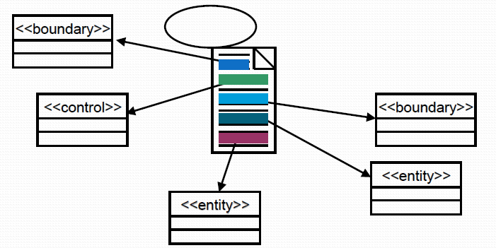
Find Classes From Use-Case Behavior
The complete behavior of a use case has to be distributed to analysis classes
We must ‘identify’ these classes – identify, name, and briefly describe in a few sentences.

Slide 16
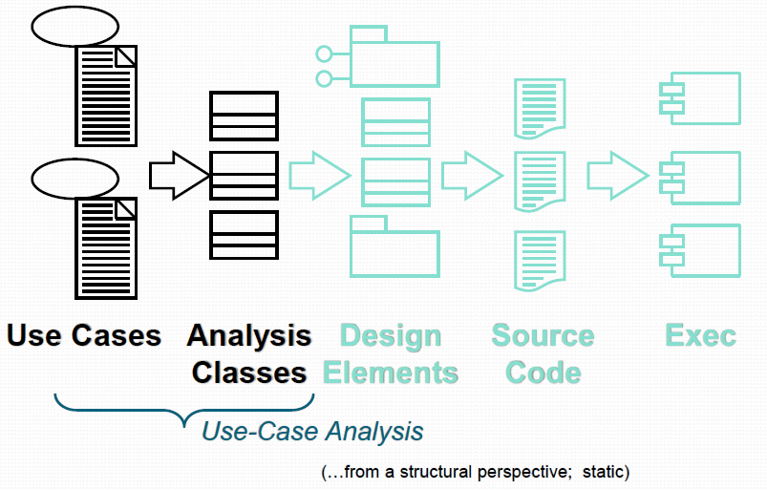
Analysis Classes: A First Step Towards Executables

Slide 17
Discovering Classes
Analysis classes represent an early conceptual model for ‘things in the system which have responsibilities and behaviors’.
Analysis classes are used to capture a ‘first-draft’, rough-cut of the object model of the system.
Analysis classes handle primary functional requirements, interface requirements, and some control - and model these objects from the problem domain perspective.

Slide 18
How to find Analysis Classes
To help us understand how to approach OOAD, RUP provides a pattern that we will apply to the use case realization process
Patterns address common design problems by providing generalized solutions for these problems
The major benefit of utilizing a pattern is that the pattern documents existing, well-proven design experience

Slide 19
Entity , Control, and Boundary Design Pattern
The ECB pattern represents a refinement of the model-view-controller (MVC) design pattern, a pattern that dates back to the early days of the Smalltalk-80 object-oriented language
The goal of the MVC design pattern is to decompose the application into three distinct types of objects:
Model Objects: It expresses the application's behavior
View Objects: any output representation of information
Controller Objects: accepts input and converts it to commands for the model or view

Slide 20
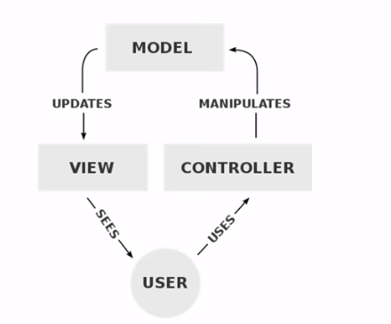
MVC Pattern

Slide 21
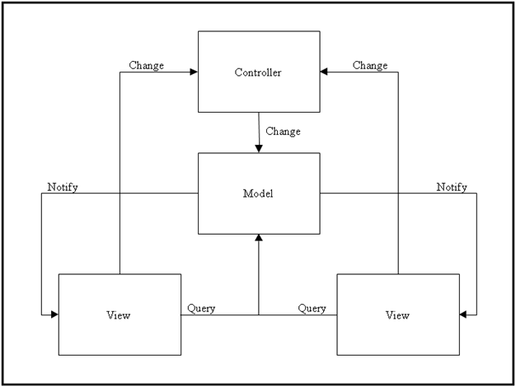
MVC Pattern

Slide 22
Entity, Control, and Boundary Design Pattern
The ECB design pattern is closely related to the MVC design pattern
As such, its goal is to decompose the application into three distinct types of objects:
Boundary objects
Control objects
Entity objects
Rules govern how each of these objects can communicate with the other objects associated with the pattern
The primary distinction between these two design patterns is the rules that govern object communication

Slide 23
Entity, Control, and Boundary Design Pattern
This innovative approach to analysis and design was originally introduced by Doug Rosenberg and Kendall Scott
Stereotypes (i.e., a meta-classification of an element) based upon these three object types are available in UML packages for creating interaction and class diagrams
Once this pattern has been described, an analysis or design model will become very recognizable

Slide 24
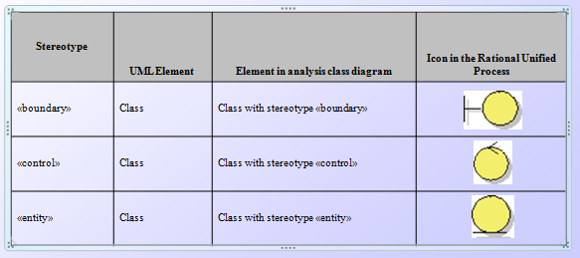
Entity, Control, and Boundary Design Pattern

Slide 25
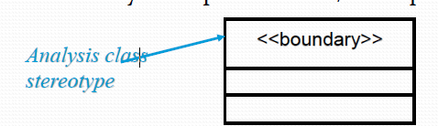
Boundary Objects
Boundary objects are responsible for supporting communications between the system’s external environment and its internal workings (i.e., control and entity objects)
Within the context of use case realization, there will be one boundary class for each user interface
The actor(s) identified within the Use Case Model will always interact with the system through these boundary objects
Notes:
Boundary objects are responsible for supporting communications between the system’s external environment (e.g., its users, other systems, or hardware devices) and its internal workings (i.e., control and entity objects)

Slide 26
Boundary Class
Insulates the system from changes in the outside
Several Types of Boundary Classes
User interface classes – classes that facilitate communication with human users of the system
Menus, forms, etc. User interface classes….
System interface classes – classes which facilitate communications with other systems.
These boundary classes are responsible for managing the dialogue with the external system, like getting data from an existing database system or flat file…
Provides an interface to that system for this system
Device Interface Classes – provide an interface to devices which detect external events – like a sensor
Notes:
One boundary class per use case/actor pair

Slide 27
Boundary Class
Within the various interaction and class diagrams, a boundary class is commonly used as a placeholder for a GUI that will be created using the features and capabilities provided by an integrated development environment (IDE)
Boundary classes will also be used to support communications with legacy systems
In these instances, the legacy system will be modeled as an actor and a boundary class will be created to provide the actor with an interface to the system
Notes:
Boundary classes, however, are not used exclusively as a placeholder for a GUI
Unlike view objects within the MVC pattern, a boundary object will always interface with a control object and never directly with an entity class

Slide 28
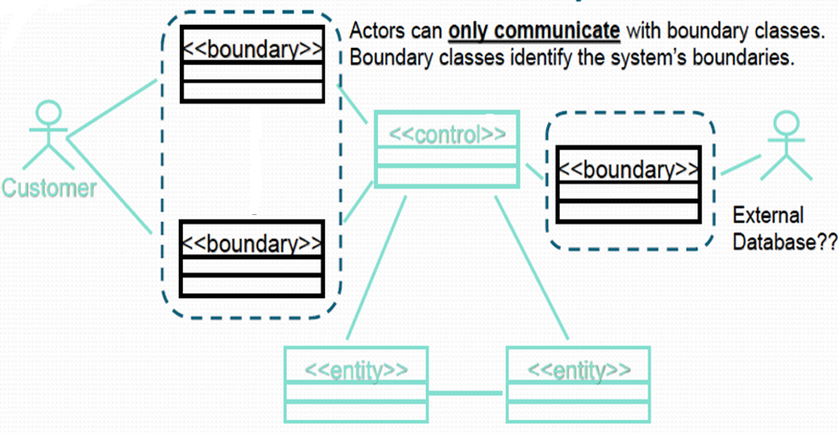
The Role of Boundary Class

Slide 29
Boundary Class- More
Identify boundary classes for things mentioned in the flow of events of the use-case realization.
Consider the source for all external events and make sure there is a way for the system to detect these events. (user inputs/responses? Connection to existing external data…)
One recommendation: for the initial identification of boundary classes is one boundary class per actor/use-case pair.
This class can be viewed as having responsibility for coordinating the interaction with the actor.
This may be refined as a more detailed analysis is performed.
This is particularly true for window-based GUI applications, where there is typically one boundary class for each window, or one for each dialog.

Slide 30
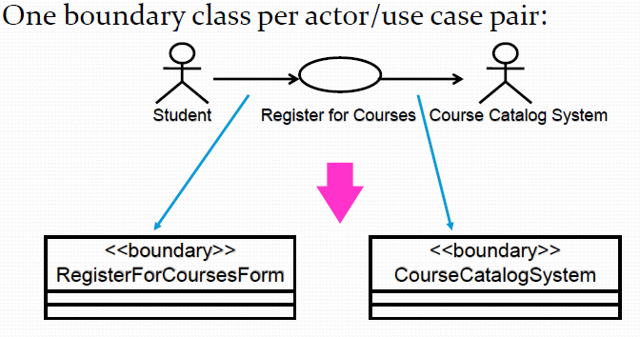
Example: Finding Boundary Class
The RegisterForCoursesForm contains a Student's "schedule-in-progress".
It displays a list of Course Offerings for the current semester from which the Student may select to be added to his/her Schedule.
The CourseCatalogSystem interfaces with the legacy system that provides the complete catalog of all courses offered by the university.
Notes:
By the 1980s it was commonly used to refer to existing computer systems to distinguish them from the design and implementation of new systems. Legacy was often heard during a conversion process, for example, when moving data from the legacy system to a new database.

Slide 31
Guidelines: Boundary Class – User Interface classes
User Interface Classes
Concentrate on what information is presented to the user
Do NOT concentrate on the UI details
Analysis Classes are meant to be a first cut at the abstraction of the system.
Do not do a GUI design in analysis, but isolate all environment-dependent behavior.
The expansion, refinement and replacement of these boundary classes with actual user interface classes is a very important activity of Class Design.
If prototyping the interface has been done, these screen dumps or sketches may be associated with a boundary class.
Only model the key abstractions of the system – not every button, list, etc. in the GUI.

Slide 32
Guidelines: Boundary Classes – System and Device
System and Device Interface Classes
Concentrate on what protocols must be defined
Note that your application must interface with an existing ‘information source.’
Do NOT concentrate on how the protocols will be implemented
If the interface to an existing system or device is already well-defined, the boundary class responsibilities should be derived directly from the interface definition.
If there is a working communication with the external system or device, make note of it for later reference during design.
Notes:
http://sce.uhcl.edu/helm/RationalUnifiedProcess/process/modguide/md_acls2.htm

Slide 33
Control Classes
Control objects are responsible for application specific business logic
In addition, these object types also function as an intermediary between the system’s various boundary and entity objects
Within the context of use case realization, each boundary class will communicate with a single control class and control classes will be used to manage each use case’s flow of execution

Slide 34
Control Classes
To manage this flow, the control object must coordinate the activities required to support the use case realization, including interactions with other control objects and the data aware entity objects
Each entity object will be tightly coupled with a control object

Slide 35
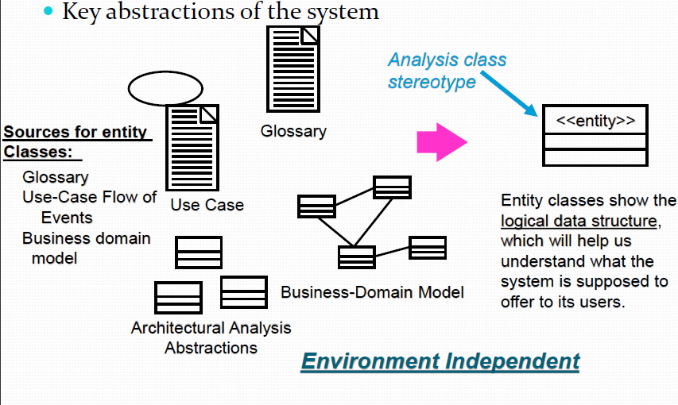
What is an Entity Class? (recall: boundary, entity, control…)

Slide 36
Entity Classes
Entity classes represent stores of information in the system
They are typically used to represent the key items the system manages.
Entity objects (instances of entity classes) are used to hold and update information about some phenomenon, such as an event, a person, or some real-life object.
(advisor, teacher, university, student etc.)
They are usually persistent, having attributes and relationships needed for a long period, sometimes for the life of the system.
The main responsibilities of entity classes are to store and manage information in the system.

Slide 37
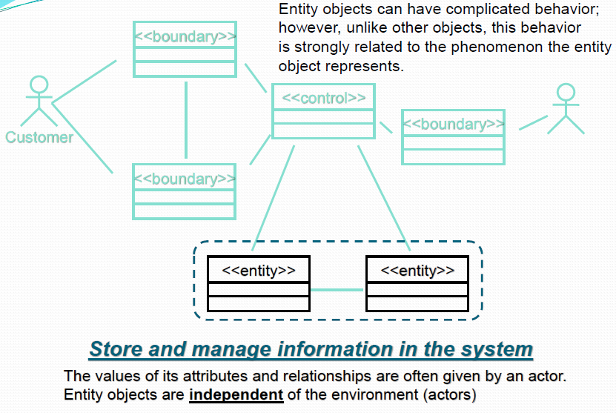
The Role of an Entity Class

Slide 38
Entity Object
To display the data, the data encapsulated within the entity object will traverse a path that eventually leads to the control object that is tightly coupled to the boundary object
At this point, the data will be passed to the boundary object for displaying in the GUI

Slide 39
Candidate Entity Classes
Sometimes there is a need to model information about an actor within the system. This is not the same as modeling the actor (actors are external by definition).
For example, a course registration system maintains information about the student which is independent of the fact that the student also plays a role as an actor of the system.
This information about the student that is stored in a ‘Student’ class is completely independent of the ‘actor’ role the student plays; the Student class (entity) will exist whether or not the student is an actor to the system.
Notes:
These classes are sometimes called “surrogates”.

Slide 40
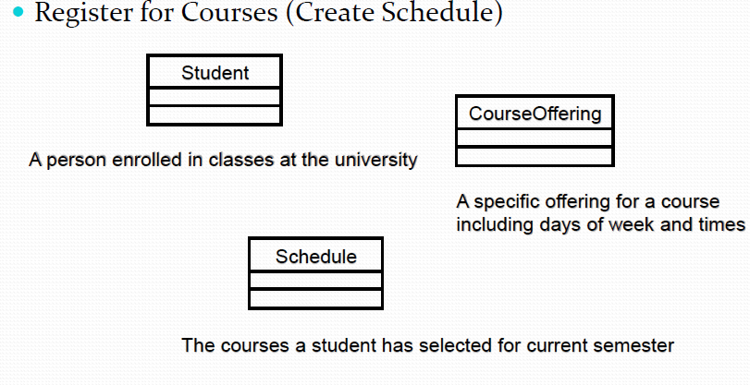
Example: Candidate Entity Classes

Slide 41
What is an Analysis Class?
A class that represents initial data and behavior requirements, and whose software and hardware oriented details have not been specified
Analysis class diagram – a UML diagram showing analysis classes and their relationships

Slide 42
Analysis Classes in a Nut Shell
Entity class :
Persistent data
used multiple times and in many UCs)
Still exists after the UC terminates (e.g. DB storage)
Boundary class:
(User) interface between actors and the system
E.g. a Form, a Window (Pane)
Control class:
Encapsulates business functionality
Proposed in RUP (Rational Unified Process)

Slide 43
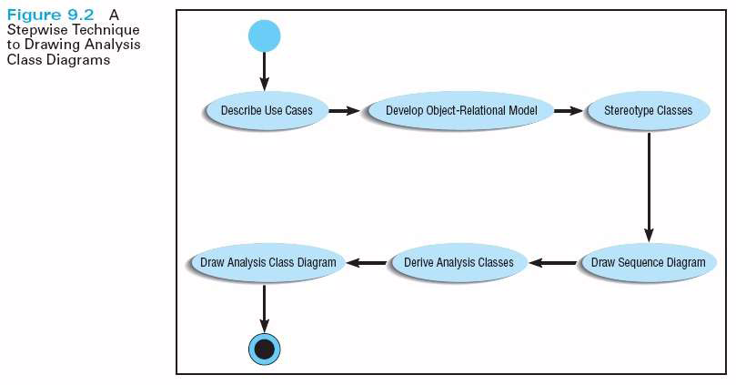

Slide 44
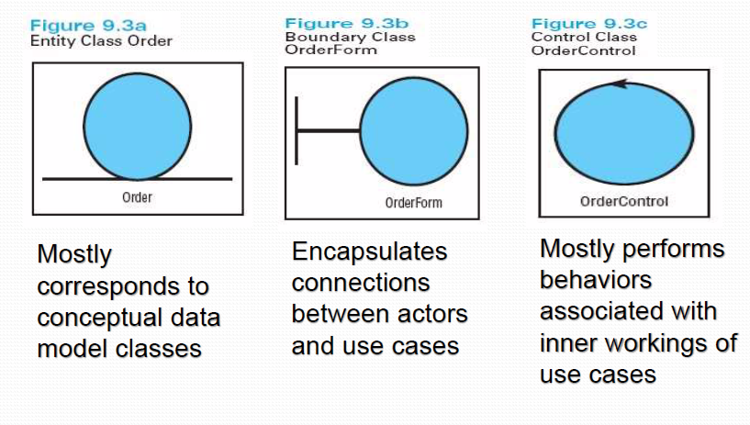
Stereotypes of Analysis Classes

Slide 45
ECB Pattern
Collaborating together, the various boundary, control, and entity objects within the BCE design pattern realize the behavior documented in the system’s Use Case Model
The rules that govern communication between the various object types within the BCE design pattern are illustrated in the tables that follow

Slide 46
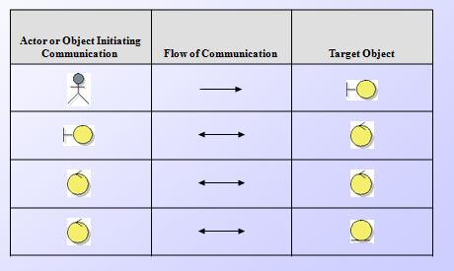
Allowed Communication within the ECB Design Pattern

Slide 47
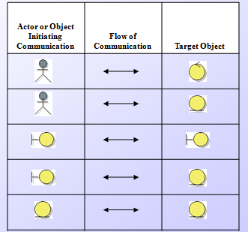
Communication Not Allowed within the ECB

Slide 48
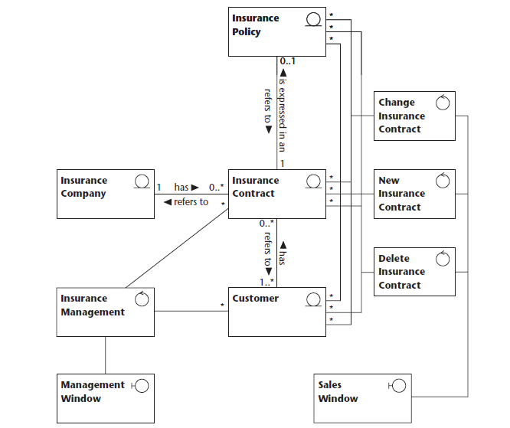
`
The entity classes capture the core business, in this case, the insurance business. The entity classes are Insurance Policy, Insurance Contract, Customer, and Insurance Company. The control classes Change Insurance Contract, New Insurance Contract, and Delete Insurance Contract serve the boundary class Sales Window. The control class Insurance Management serves the Management Window with Customers and Insurance Contracts.

Slide 49
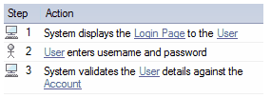
Robustness Diagram Activity

Slide 50
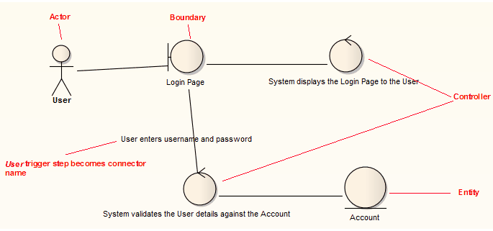

Slide 51
What Is Robustness Analysis?
Involves analyzing the narrative text of each of the use cases and identifying a first-guess set of the objects into entity, boundary, and control classes
Requires completeness checks and adherence to diagramming rules

Slide 52
Robustness Diagram- ECB Pattern(Example)
The UNIVERSITY OF KARACHI registration system is briefly described thus:
You have been asked to streamline, improve, and automate the process of assigning professors to courses and the registration of students such that it takes advantage of prevailing web technologies for on-line real time, location independent access.
The process begins by professors deciding on which courses they will teach for the semester. The Registrar’s office then enters the information into the computer system, allocating times, room, and student population restrictions to each course. A batch report is then printed for the professors to indicate which courses they will teach. A course catalogue is also printed for distribution to students.

Slide 53
Robustness Diagram- ECB Pattern(Example)
Students then select what courses they desire to take and indicate these by completing paper-based course advising forms. They then meet with an academic advisor who verifies their eligibility to take the selected courses, that the sections of the courses selected are still open, and that the schedule of selected courses does not clash. The typical student load is four courses.
The advisor then approves the courses and completed the course registration forms for the student. These are then sent to the registrar who keys them into the registration system – thereby formally registering a student. If courses selected are not approved, the student has to select other courses and complete the course advising forms afresh.

Slide 54
Robustness Diagram- ECB Pattern(Example)
Most times students get their first choice, however, in those cases where there is a conflict, the advising office talks with the students to get additional choices. Once all students have been successfully registered, a hard copy of the students’ schedule is sent to the students for verification.
Most student registrations are processed within a week, but some exceptional cases take up to two weeks to resolve.
Once the initial registration period is over, professors receive a student roster for each class they are scheduled to teach.

Slide 55
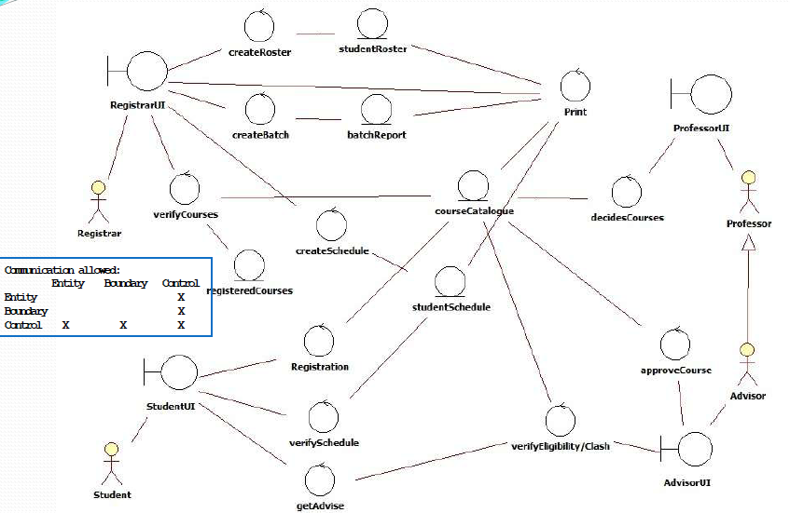
Robustness Diagram- ECB Pattern(Example)

Slide 56
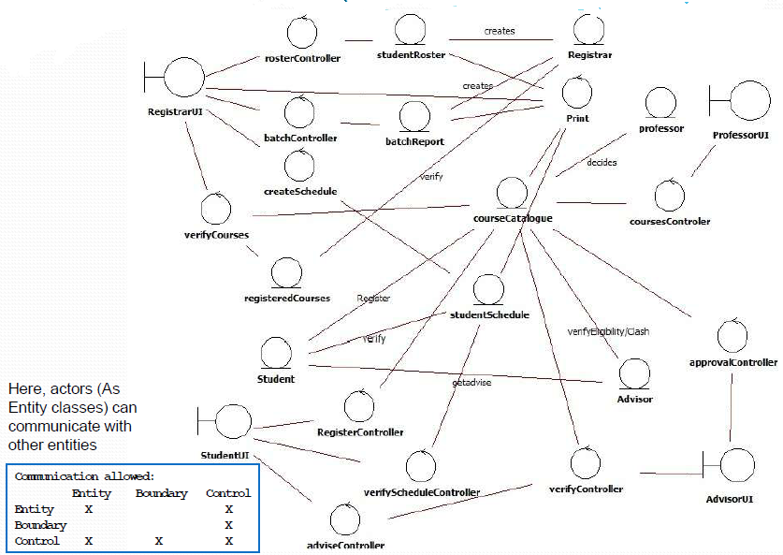
Robustness Diagram- ECB Pattern(Example)

Slide 57
That is all

